Slide 1
Tech Outlook 2020
Can You Keep up with the Speed of Disruption?

Slide 2
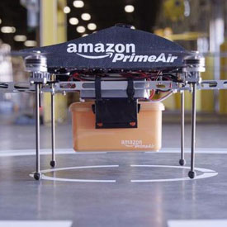
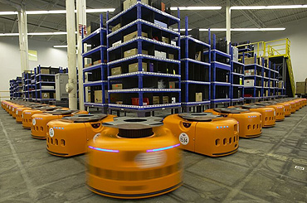
Last Year’s Disruptor

Slide 3
A Lookback to 2015
Cheap Capital
Technology
Cloud
Mobile
Uberization

Slide 4
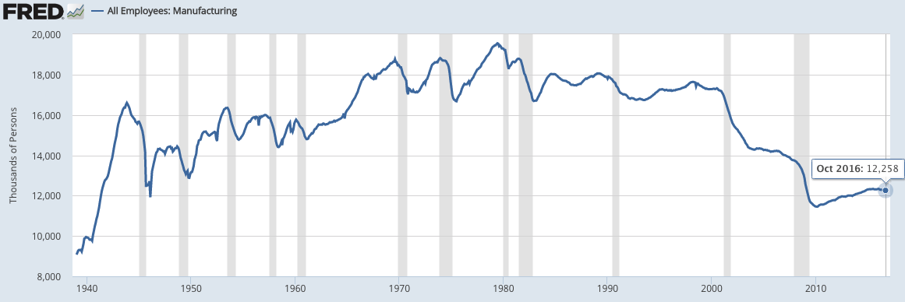
So Where Have all the Manufacturing Jobs Gone?
What Happened to Industrial Production During the Same Period?

Slide 5
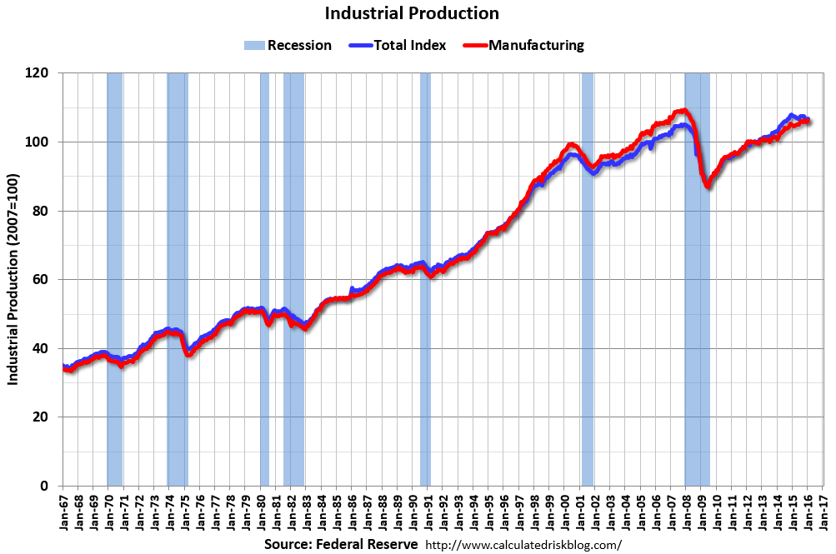
The Answer: It has Risen 250%

Slide 6
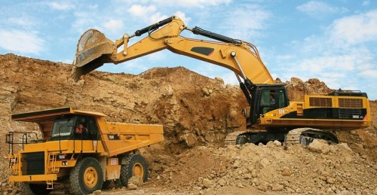
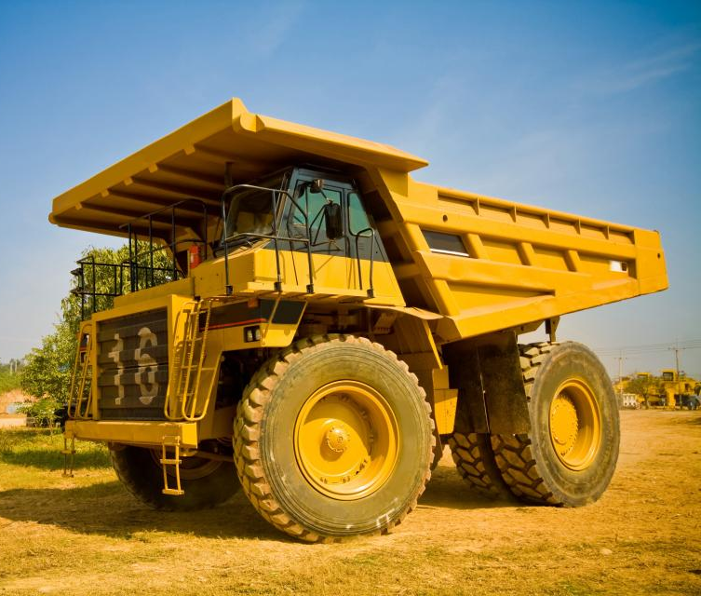
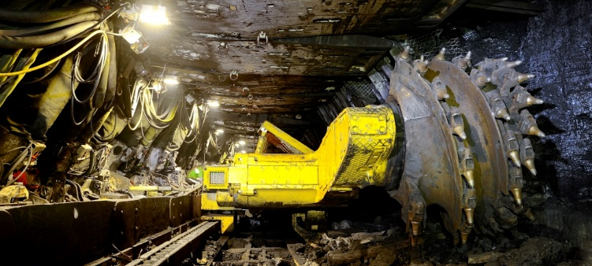
Who has the Highest Productivity Improvement?
Mining: 1 Person today does the work handled by 30 people, 40 years ago

Slide 7
4 Secular Changes
Utility Explodes
Digitization
Technology Enhance-ments
Capital Over Labor

Slide 8
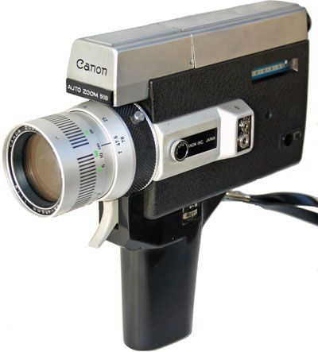
Utility
+
+

Slide 9
Utility

Slide 10
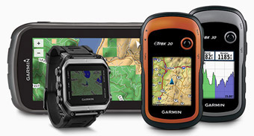
Utility
C
+
+

Slide 11
Utility

Slide 12
Digital Over Physical
Who has:
Cable or satellite TV
Internet
2+ cell phones
Premium TV (HBO)
Internet TV (Netflix)
XM Radio
$600 monthly in data
+

Slide 13
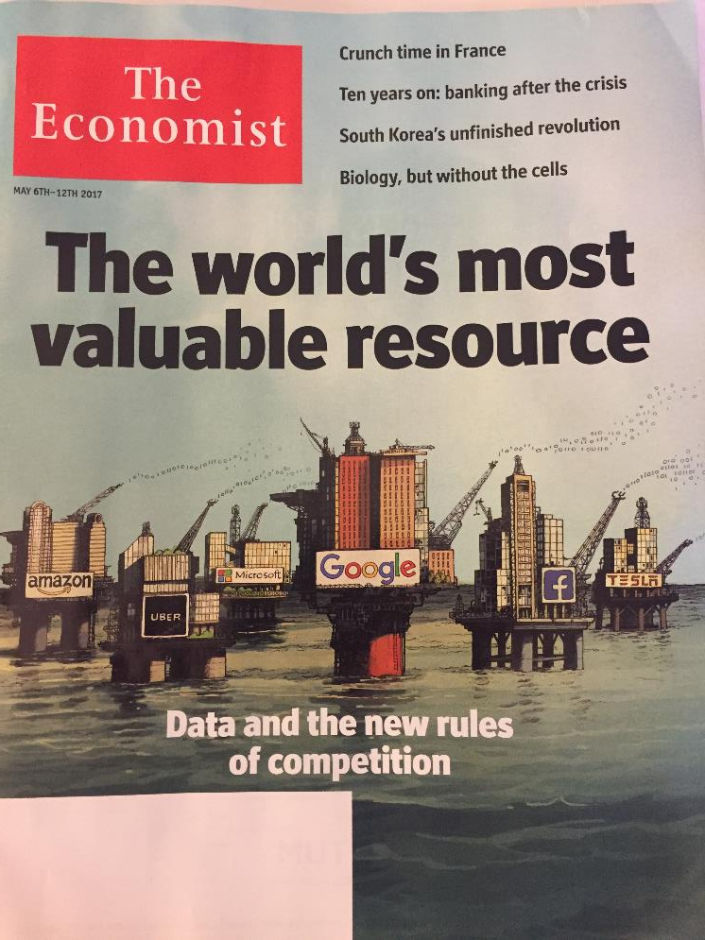

Slide 14
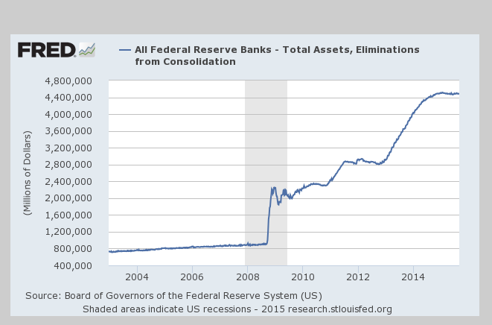
Substitute Capital for Labor

Slide 15
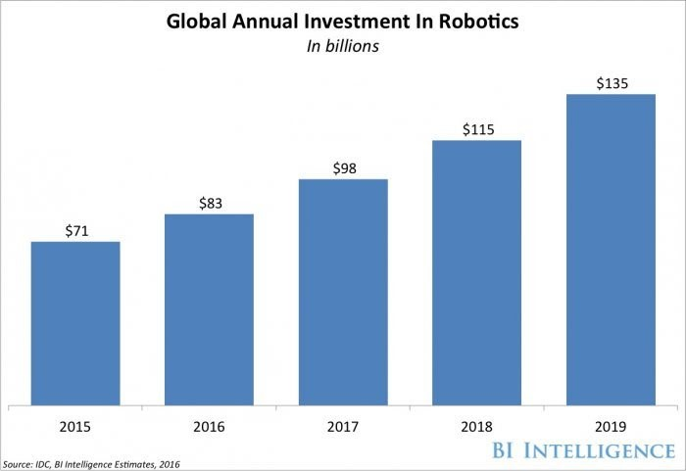
Investment in Robotics

Slide 16
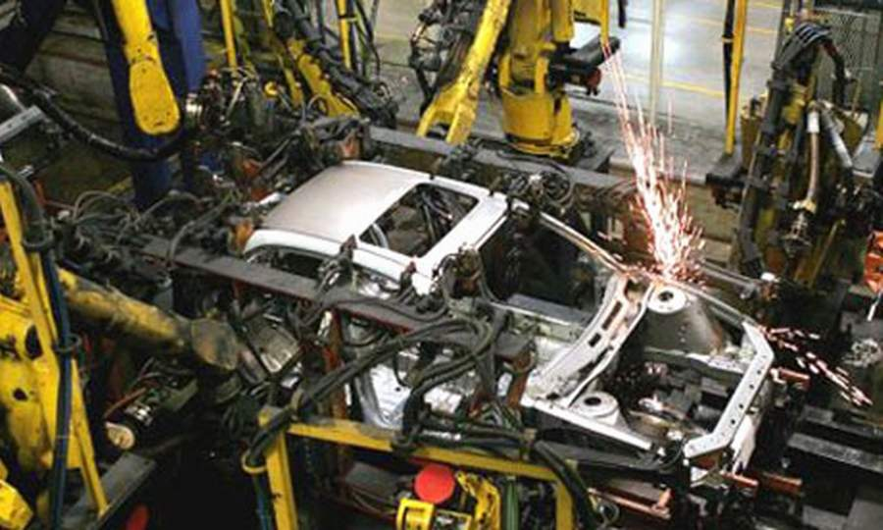
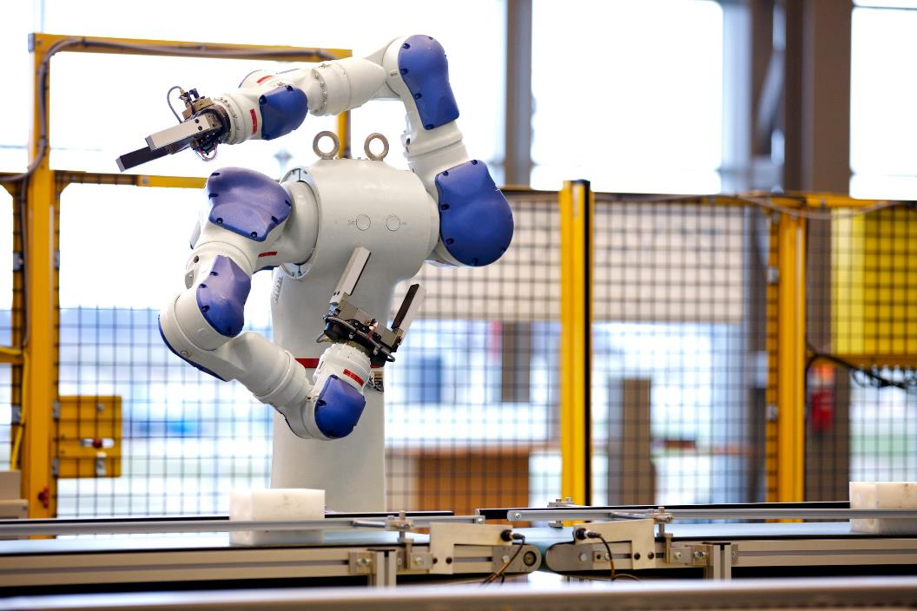

Slide 17
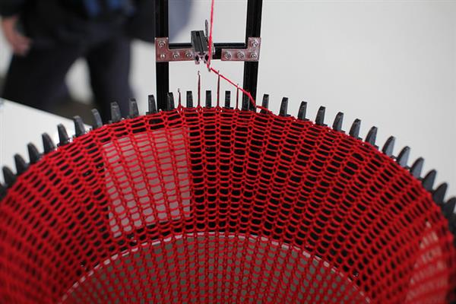
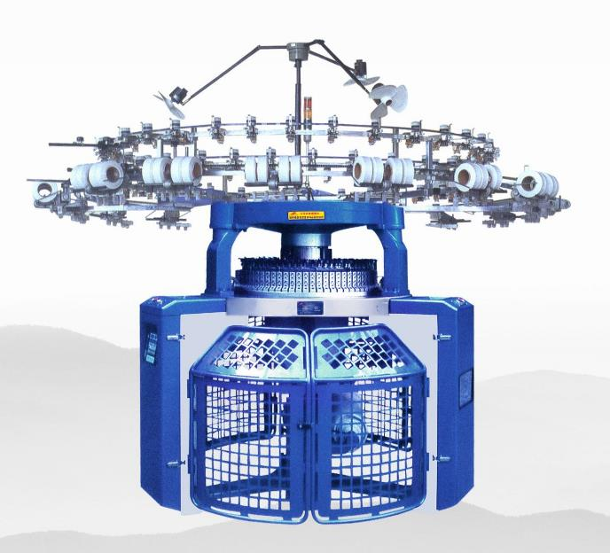
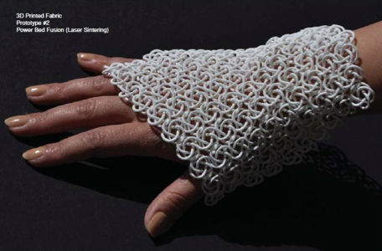
3D Knitting

Slide 18
Shima Seiki Sewing free knits

Slide 19
Technology Hits a Higher Gear

Slide 20
Material Science

Slide 21
Graphene Aerogel

Slide 22
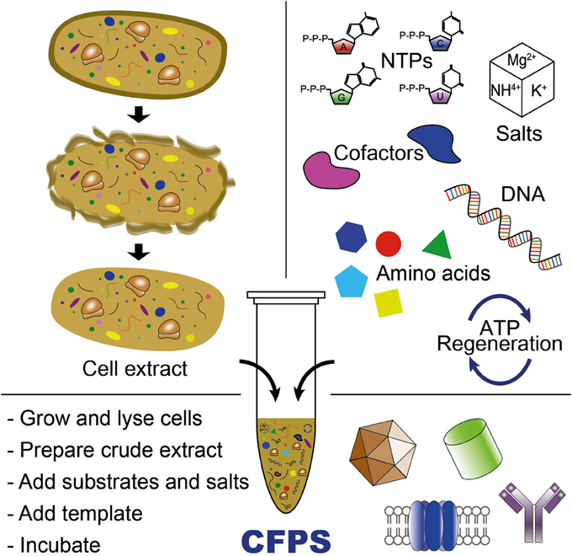
Bioscience - Cell Free Protein Synthesis

Slide 23
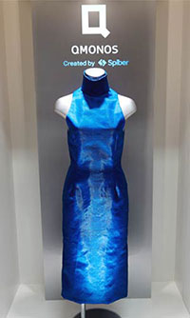
Synthetic Spider Silk

Slide 24
How we Communicate Continues to Evolve

Slide 25
Platforms Continue to Expand
CRM, force.com
Payments, POs
Alexa, Echo
Web dev, Commerce

Slide 26
Growing Trends that will Continue to Expand
M.G. Siegler, general partner at GV (formerly Google Ventures)
“Artificial intelligence and machine learning are the obvious trends to continue gaining speed into next year. One offshoot of those I’m particularly interested in: I think both vocal and audible computing will continue to get a lot more exciting in 2017. Obviously, products like the Amazon Echo and, more recently, Google Home, have planted the seeds for this. Heading into next year, I suspect products like Apple’s AirPods will expand the trend in different ways.”
http://venturebeat.com/2016/12/26/vc-predictions-for-2017/

Slide 27
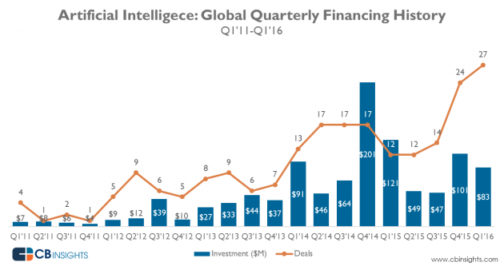

Slide 28
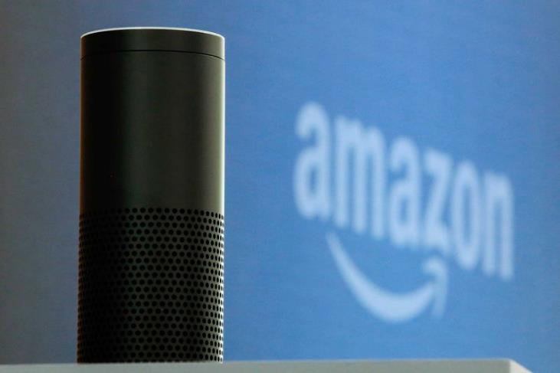
AI & Speech Recognition
7 million homes

Slide 29
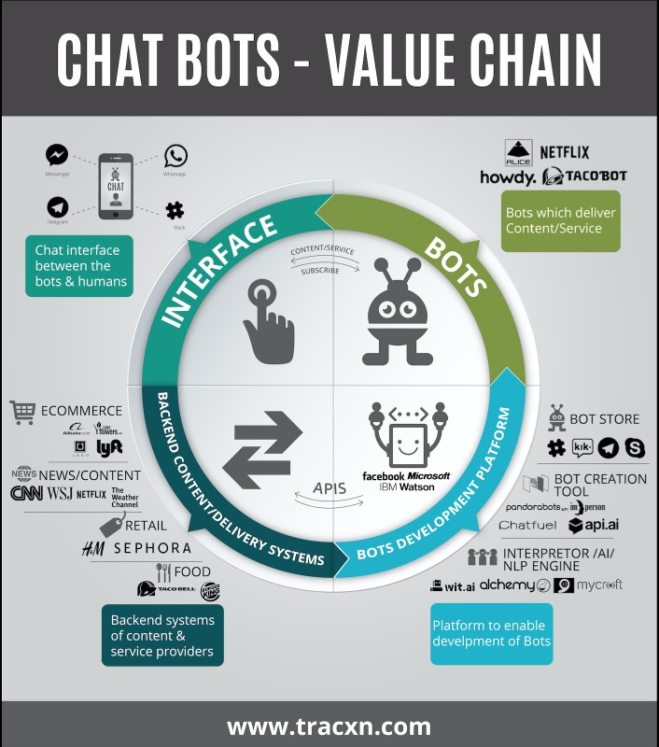
Chat bots

Slide 30
Machine Learning
Bayesian Statistics – Probability Curves
Sentiment Analysis – Recommendation Engines - Natural Language
Factorization Machines (2012)
Solvers
Google TensorFlow – Recurrent & Deep Neural Networks
Stochastic Gradient Point Descent

Slide 31
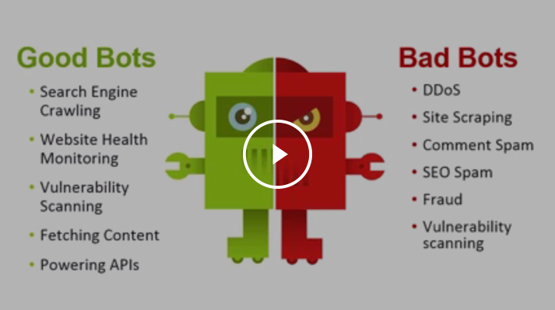

Slide 32
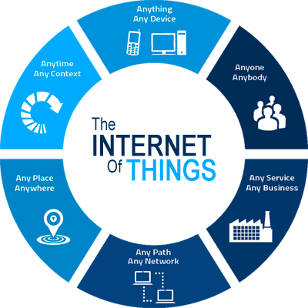
Global IoT spend in manufacturing to reach $70 billion by 2020
20 billion connected devices by 2020

Slide 33
Connected Clothing

Slide 34
Technology Impact on Commodities

Slide 35
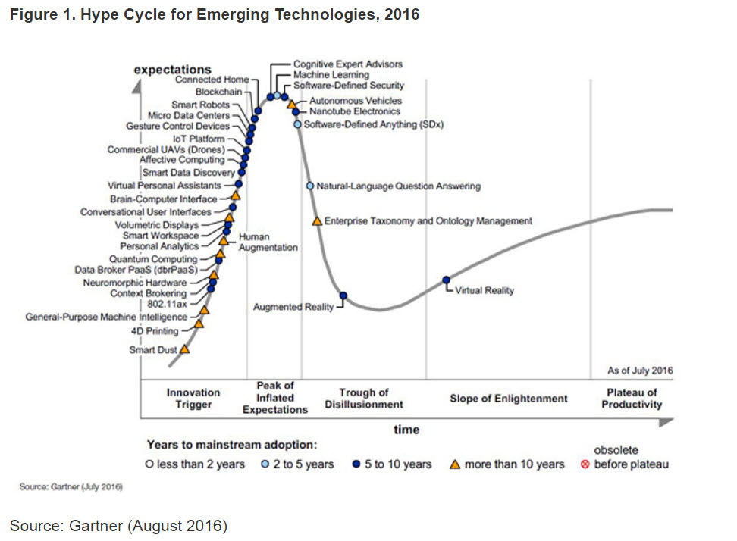

Slide 37
The Future?
How will this impact your business?
How will this impact your customers?
How will this impact you?

